Slide 1

UART & SPI ADC Interface with 8051 (8051 -5 Days Workshop)
DAY 8
EMBEDDED SYSTEM DESIGN & IoT-Master Class

Slide 2
What You will learn Today?
Introduction to UART
How it works
UART Transmit and Receive
Introduction to SPI
MCP3202
How to read ADC Data and Display in UART

Slide 3
Mindset Lesson for the Day
Ideas will not work unless you act on it
Exercise
Action to acquire method
Write down some specific things that you want to buy in the near future. Then focus on building a plan to acquire one of them.

Slide 4
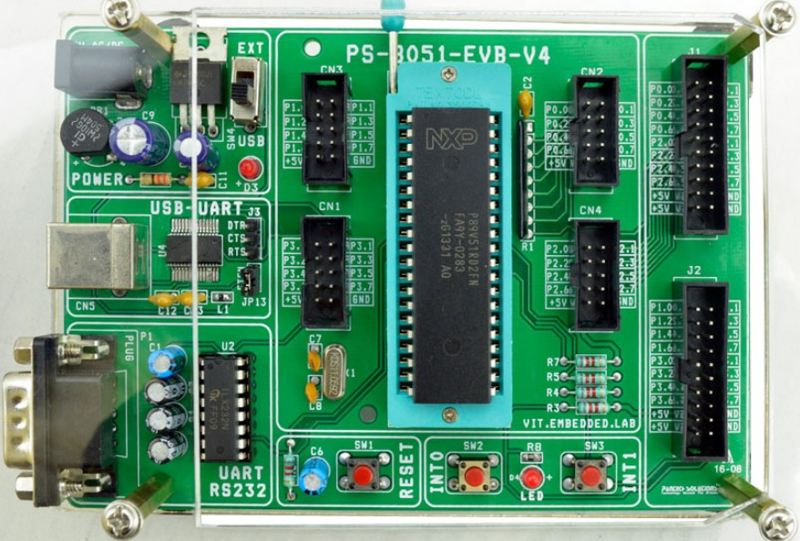
8051 Board

Slide 5
WHAT IS UART
Universal asynchronous receiver and Transmitter
Serial port, COM port, RS232, RS485
VERY COMMON AND SIMPLE
Useful for communication to
Microcontroller
Computer
Other FPGA

Slide 6
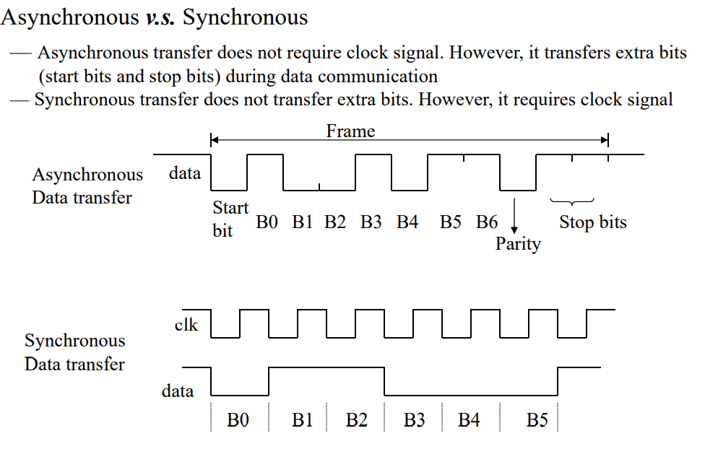
Asynchronous Vs Synchronous
Two methods of serial communication are
Synchronous Communication: Transfer of bulk data in the framed structure at a time
Asynchronous Communication: Transfer of a byte data in the framed structure at a time

Slide 7
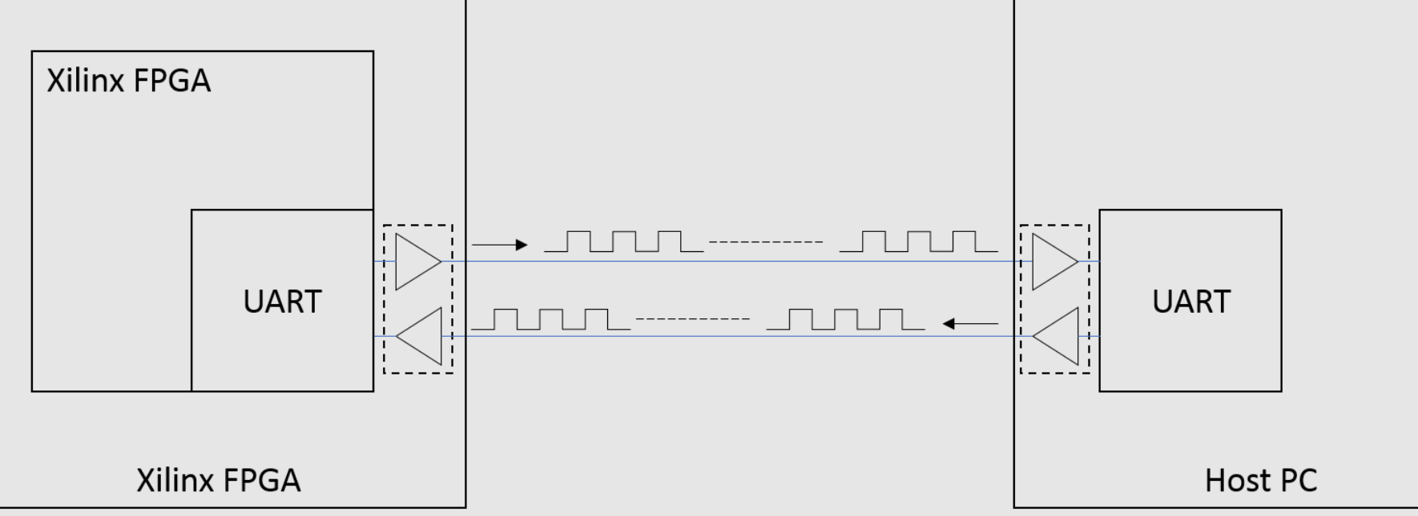
UART

Slide 8
UART PARAMETERS
Baud Rate (9600, 19200, 115200, others)
Number of Data Bits (7, 8)
Parity Bit (On, Off)
Stop Bits (0, 1, 2)
Flow Control (None, On, Hardware)

Slide 9
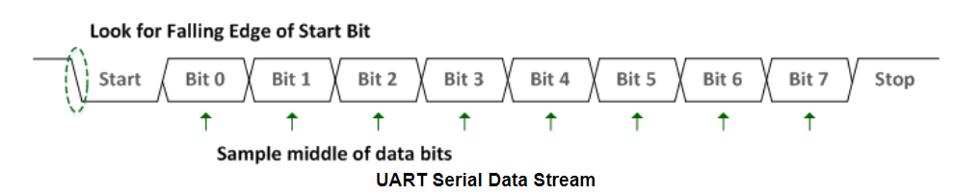
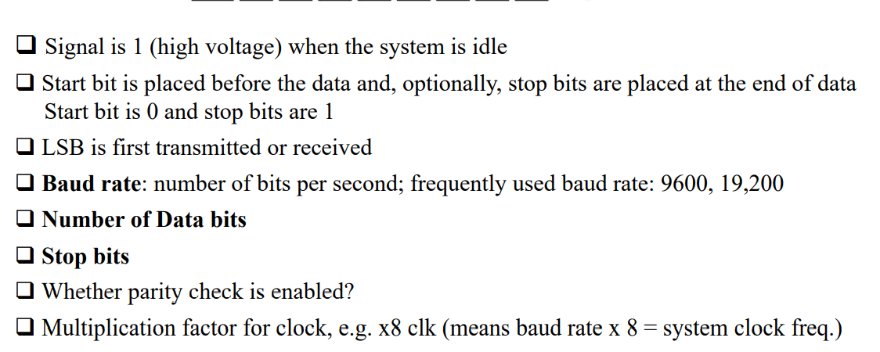
UART DATA STREAM EXAMPLE

Slide 10
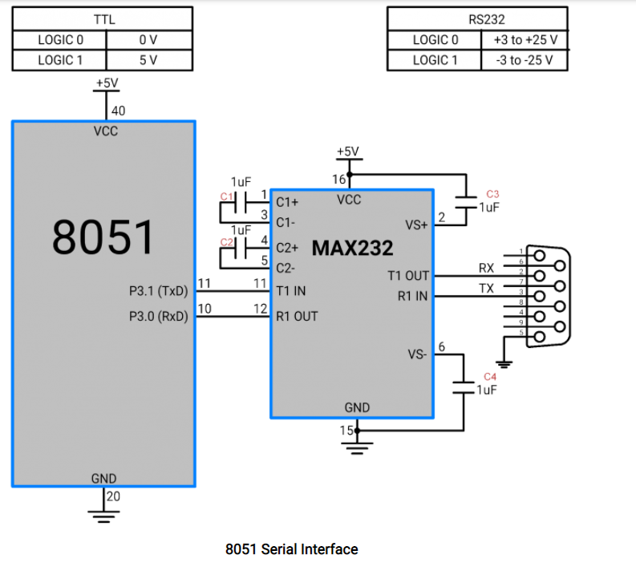
Schematic

Slide 11
UART Registers
These are the registers that must be configured for UART peripheral.
PCON: Power Control Register.
SCON: SCON is an 8-bit register for configuring serial control register.
TCON: Timer Control Register for Baud Rate Generator
TMOD: Timer Mode Control for Baud Rate Generator
SBUFF: Serial Buffer holds the data to be transmitted and the data received

Slide 12
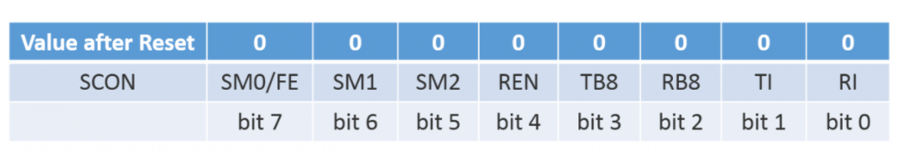
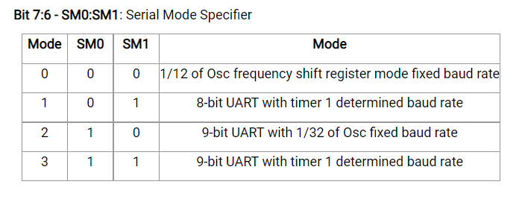
SCON Register

Slide 13
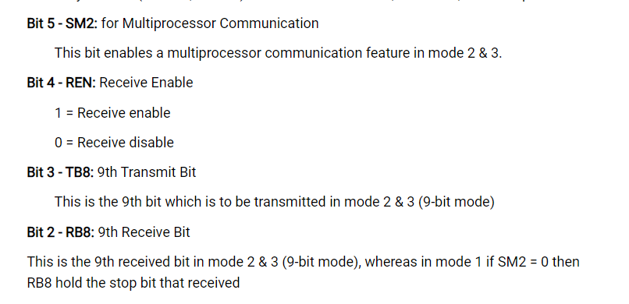
SCON Register

Slide 14
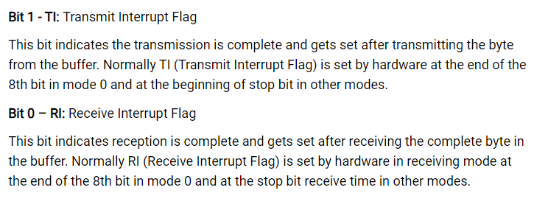
SCON Register

Slide 15
SCON Register Definitions-Summary
FE – Framing error bit.
SM0 – This bit is used for serial port mode selection.
SM1 – This bit is used for serial port mode selection.
SM2 – This bit is used for serial port mode selection, also known as multiprocessor communication enable bit. When set, it enables multiprocessor communication in mode 2 and 3, and eventually mode 1. It should be cleared in mode 0.
REN – Reception Enable bit enables serial reception when set. When cleared, serial reception is disabled.
TB8 – Transmitter bit 8. Since all registers are 8-bit wide, this bit solves the problem of transmitting the 9th bit in modes 2 and 3. It is set to transmit a logic 1 in the 9th bit.
RB8 – Receiver bit 8 or the 9th bit received in modes 2 and 3. Cleared by hardware if 9th bit received is a logic 0. Set by hardware if 9th bit received is a logic 1.
TI – Transmit Interrupt flag is automatically set at the moment the last bit of one byte is sent. It’s a signal to the processor that the line is available for a new byte to transmit. It must be cleared from within the software.
RI – Receive Interrupt flag is automatically set upon one byte to receive. It signals that byte is received and should be read quickly prior to being replaced by new data. This bit is also cleared from within the software.

Slide 16
STEP 1-Configure SCON
Load SCON with serial mode and control bits. e.g. for mode 1 and enable reception
SMO | SMI | SM2 | REN | TB8 | RB8 | TI | RI
0 | 1 | 0 | 1 | 0 | 0 | 0 | 0
SCON = 0x50; //Serial Mode1, Receive Enable

Slide 17
STEP 2-BAUD RATE CALCULATION
The main criteria for UART communication is its baud rate. Both the devices Receiver and Transmitter should be set to same baud rate for successful communication.
For the 8051 the Timer 1 is used to generate the baud rate in Auto reload mode.
The crystal frequency Fosc is divided by 12 internally which is used to execute instructions also known as Machine Clock, Mosc. The timer again divides the Mosc by 32 and uses it as the timer frequency, say Tosc.
Fosc =11.0592Mhz = 11059200
MachineCycle or Mclk = Fosc/12 = 11059200/12 = 921600
TimerClk or Tclk = Mclk/32 = 921600/32 = 28800
N= 28800/9600(BaudRate) =3
TH1 = 256-N =253 =0XFD
TH1 = 0xFD;

Slide 18
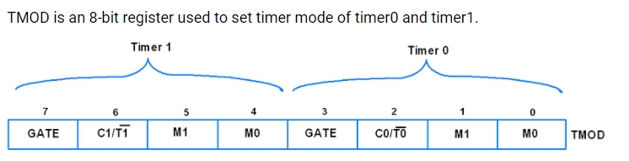
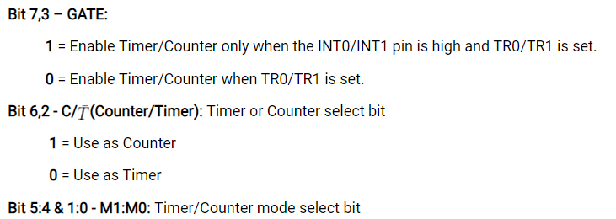
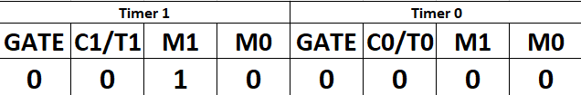
STEP 3 – Configure TMOD
TMOD = 0x20;

Slide 19
STEP 4
TR1 =1 // Enable the Timer
void UART_Init()
{
TMOD = 0x20; //Timer1, Mode2
TH1 = 0xFD; //Baud Rate 9600bps
SCON = 0x50; //Serial Mode1, Receive Enable
TR1 = 1; //Timer1 ON
}

Slide 20
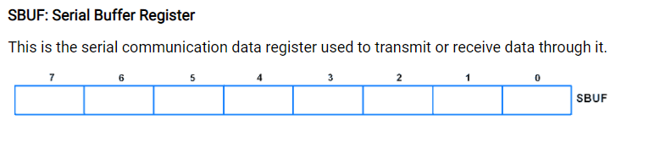
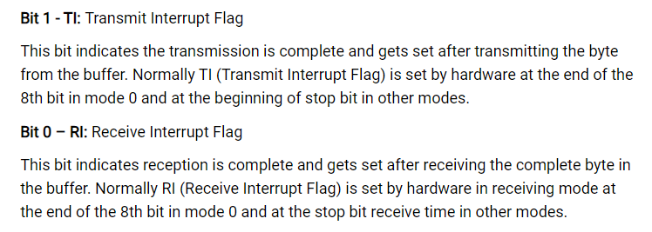
Transmit a Single Character
void UART_TxChar(char Data)
{
SBUF = Data; // DATA MOVED TO SERIAL BUFFER
while (TI==0);
TI = 0;
}

Slide 21
UART Transmit
#include <reg51.h> //Define 8051 Registers
void UART_Init();
void UART_TxChar(char);
void UART_SendString(char *);
void UART_Init()
{
TMOD = 0x20; //Timer1, Mode2
TH1 = 0xFD; //Baud Rate 9600bps
SCON = 0x50; //Serial Mode1, Receive Enable
TR1 = 1; //Timer1 ON
}
void UART_TxChar(char Data)
{
SBUF = Data; // DATA MOVED TO SERIAL BUFFER
while (TI==0);
TI = 0;
}
void UART_SendString(char *str)
{
int i;
for(i=0;str[i]!=0;i++)
{
UART_TxChar(str[i]);
}
}

Slide 22
void main()
{
UART_Init();/* initialize UART Tx=P3^0 and Rx=P3^1 */
while(1)
{
UART_SendString("Hello World!\n\r");
}
}

Slide 23
UART Transmit and Receive
#include <reg51.h> /* include UART library */
void UART_Init();
void UART_TxChar(char);
char UART_RxChar();
void UART_SendString(char *);
void UART_Init()
{
TMOD = 0x20;
TH1 = 0xFD;
SCON = 0x50;
TR1 = 1;
}
void UART_TxChar(char Data)
{
SBUF = Data;
while (TI==0);
TI = 0;
}
char UART_RxChar()
{
char dat;
while (RI==0);
RI = 0;
dat = SBUF;
return(dat);
}

Slide 24
UART Transmit and Receive
void UART_SendString(char *str)
{
int i;
for(i=0;str[i]!=0;i++)
{
UART_TxChar(str[i]);
}
}
void main()
{
char Data_in;
UART_Init(); /* initialize UART Tx=P3^0 and Rx=P3^1 */
while(1)
{
Data_in = UART_RxChar(); /* receive char serially */
UART_TxChar(Data_in);
}
}

Slide 25
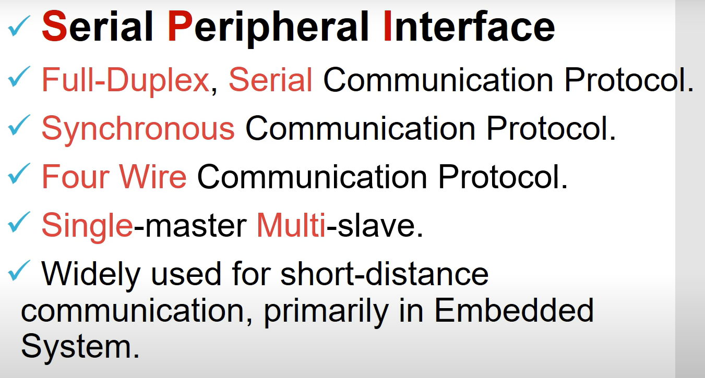
Introduction to SPI

Slide 26
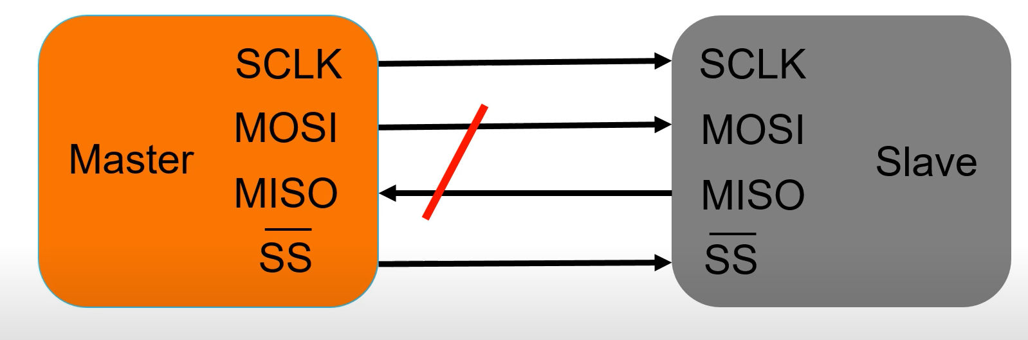
Master and Slave Mode

Slide 27
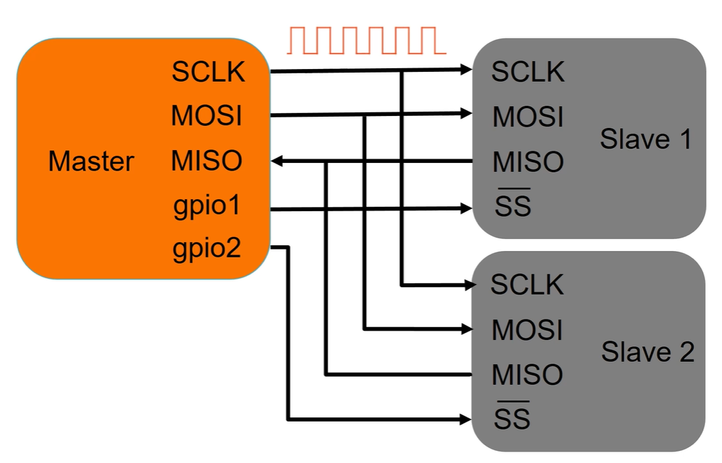
Master and Slave Mode –Multiple Slave

Slide 28
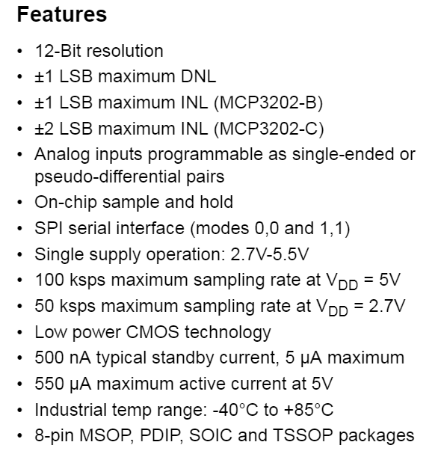
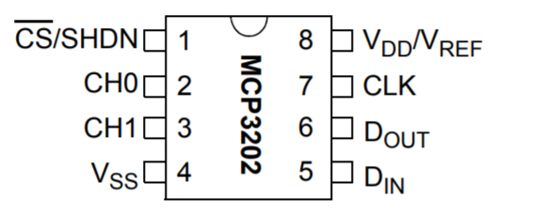
MCP3202 ADC Interface

Slide 29
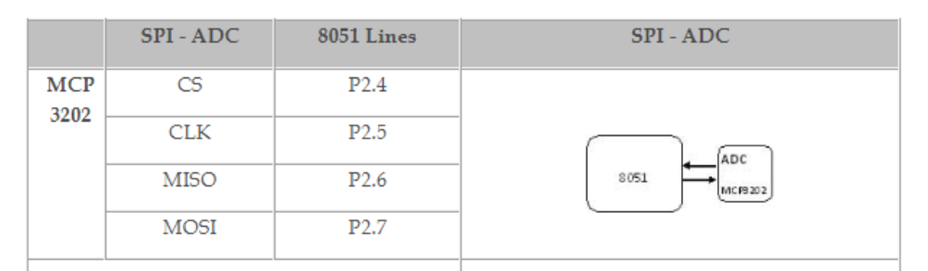
PIN Assignments with 8051

Slide 30
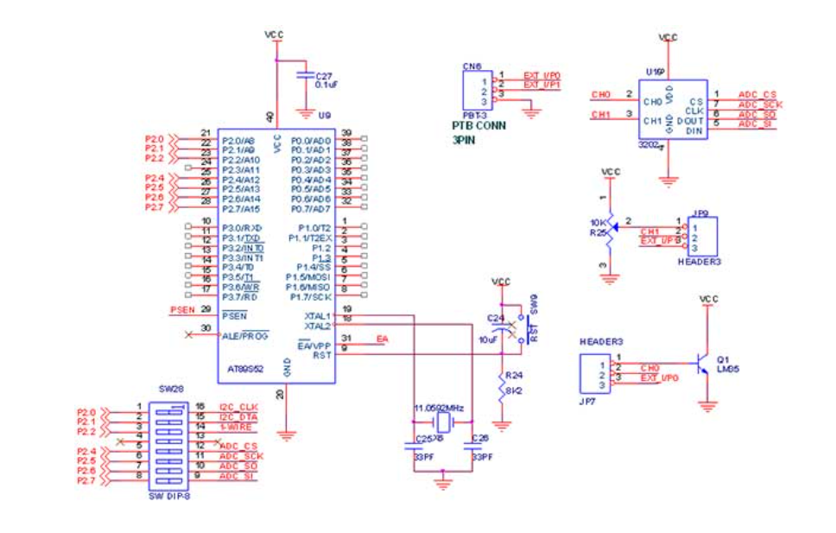
Circuit Diagram to Interface SPI ADC

Slide 31
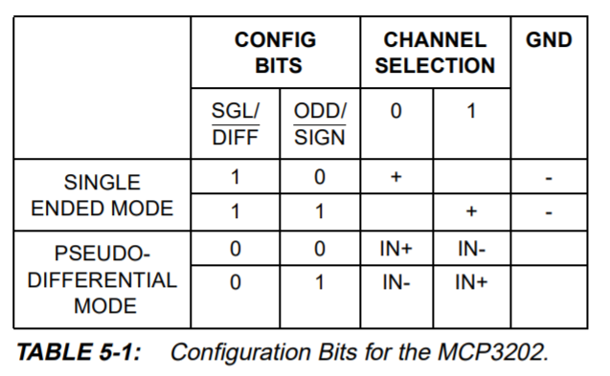
Configuration Bits for MCP3202

Slide 32
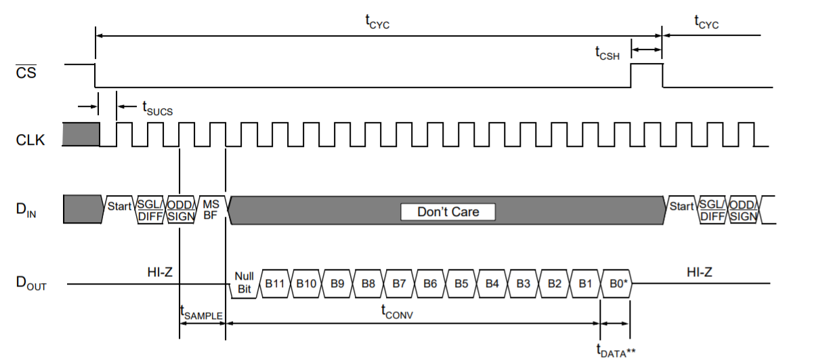
Timing Waveform

Slide 33
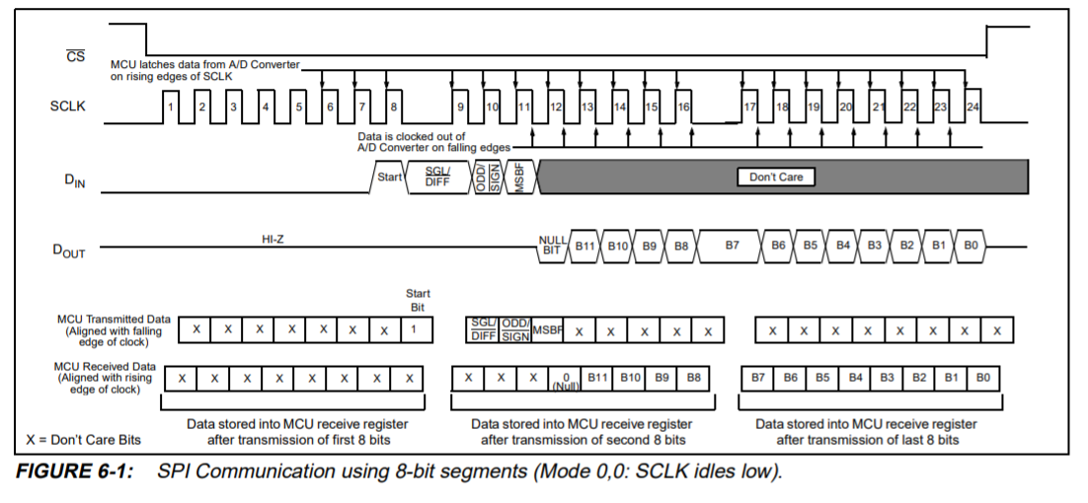
Timing Waveform

Slide 34
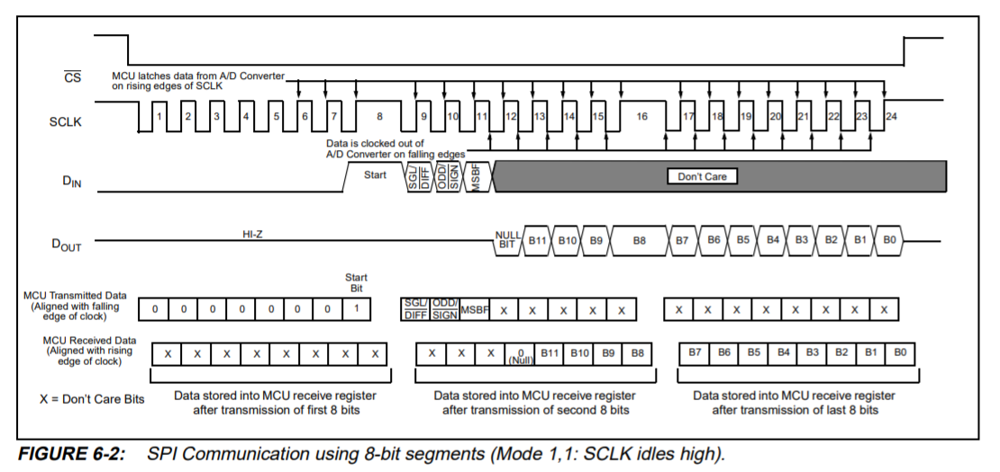
Timing Waveform

Slide 35
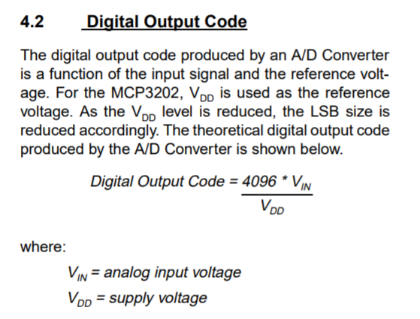
Calculation for Digital Output Code

Slide 36
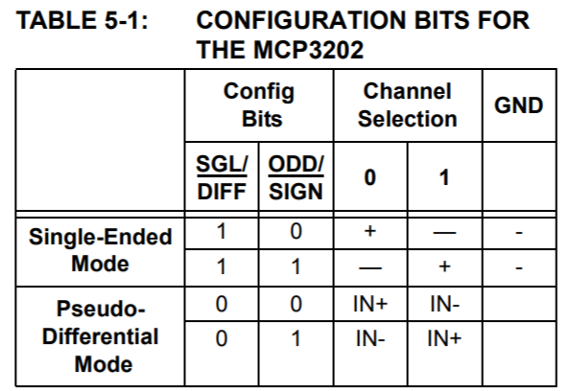
Channel Selection
channel = channel? 0xA0 : 0xD0;
channel 0 = 0xA0
channel 1 = 0xD0

Slide 37
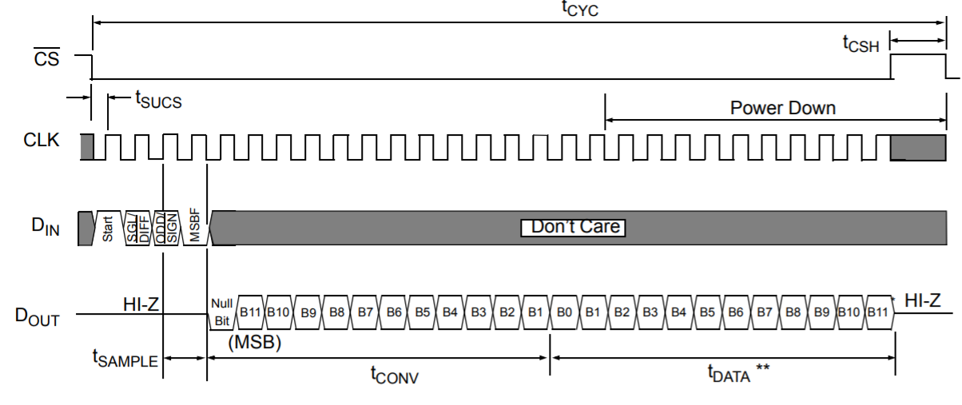
Timing Diagram

Slide 38
#include<reg52.h>
#include<stdio.h>
sbit ADC_CS = P2^4;
sbit ADC_CLK = P2^5;
sbit ADC_DO = P2^6;
sbit ADC_DI = P2^7;
void InitSerial(void);
unsigned int ReadADC(unsigned char channel);

Slide 39
void InitSerial(void)
{
SCON = 0x52; // setup serial port control
TMOD = 0x20; // hardware (9600 BAUD @11.05592MHZ)
TH1 = 0xFD; // TH1
TR1 = 1; // Timer 1 on
}

Slide 40
unsigned int ReadADC(unsigned char channel)
{
unsigned char i,k;
unsigned int AdcResult; // 12 bit
ADC_CS=0; // Active chip select
k++; // Delay about 1 uS
ADC_CLK=0; // make clock low first
k++;k++;
channel = channel? 0xA0 : 0xD0; //Refer Datasheet of MCP3202 - in Single Mode for Independent Channel Processing
k++;k++; // delay about 2 uS
/*--- write command 4 bit ----------*/
for(i=0; i< 4;i++)
{
// ADC_DI = (channel & 0x80) != 0;
ADC_DI = (channel & 0x80);
channel<<=1;
ADC_CLK=1;
k++;k++; // delay about 2 uS
ADC_CLK=0;
}
k++;k++; // delay about 2 uS
ADC_CLK=1;
k++;k++; // delay about 2 uS
ADC_CLK=0;
k++;k++; // delay about 2 uS

Slide 41
/* --- read ADC result 12 bit -------- */
AdcResult=0;
for(i=0;i<12;i++)
{
ADC_CLK=1;
k++;k++; /// delay about 2 uS
AdcResult<<=1;
AdcResult=AdcResult | (ADC_DO & 0x01);
ADC_CLK=0;
k++;k++; /// delay about 2 uS
}
ADC_CS=1;
return(AdcResult);
}

Slide 42
void main(void)
{
unsigned int CH0;
InitSerial(); // Initialize serial port
putchar(0x0C); // clear Hyper terminal
while(1)
{
CH0 = ReadADC (0);
printf("Ch 0 : %4d \n\r", CH0);
}
}

Slide 43
Thank You

